Slide 1
INFH5000
Information Science and Technology:
Essentials and Trends
(2024-2025 spring semester)
Lei Chen

Slide 2
Outline
Week 1: Prof. Lei Chen will give an overview of the course
Week 2 – Week 13: An instructor from each thrust (AI, CMA, DSA, IOT) will teach three courses, introducing essential techniques and trends in different fields
Week 14: (selected) group presentation

Slide 3
Assessment
Item | Percentage
(Team-based) Term Project | ~60%
Participation and Assignments Attending classes In-class activities (present in group presentation, contribute to Q&A, sharing in class, participation of optional tutorials) Quiz Off-class assignments | ~40%

Slide 4
About the Term Project
Who give the project? Self-proposed
How to form the team? Students are required to form a 5-person team (max. 3 from the same thrust).
What project is about? After you form the teams, each team needs to propose a final project that must be interdisciplinary.
You can consult TAs or instructors about the project scope.
Project evaluation:
Each project will write a final proposal and submit a 10-minute video.
The projects will be evaluated by our eight TAs

Slide 5
Lecture 1: An overview of data science
What is data science
Why is data science important
Core skills in data science

Slide 6

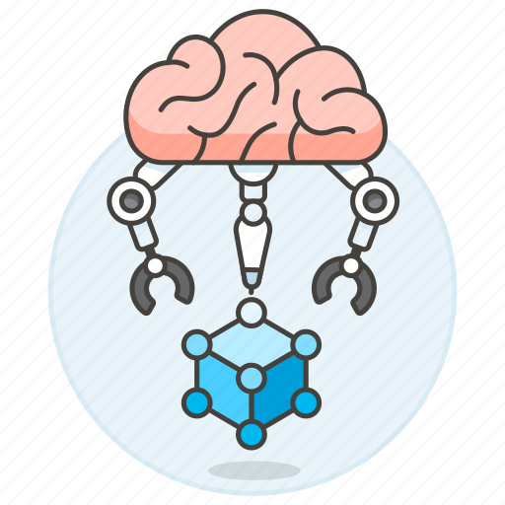

What is data science
Data
Algorithm
Data
Science
=
+

Slide 7
Data is used everywhere
Government
Finance
Medicine
Social science
Engineering
Sports
… …
Data
Notes:
Data is used everywhere to answer hard questions and make tough decisions:

Slide 8
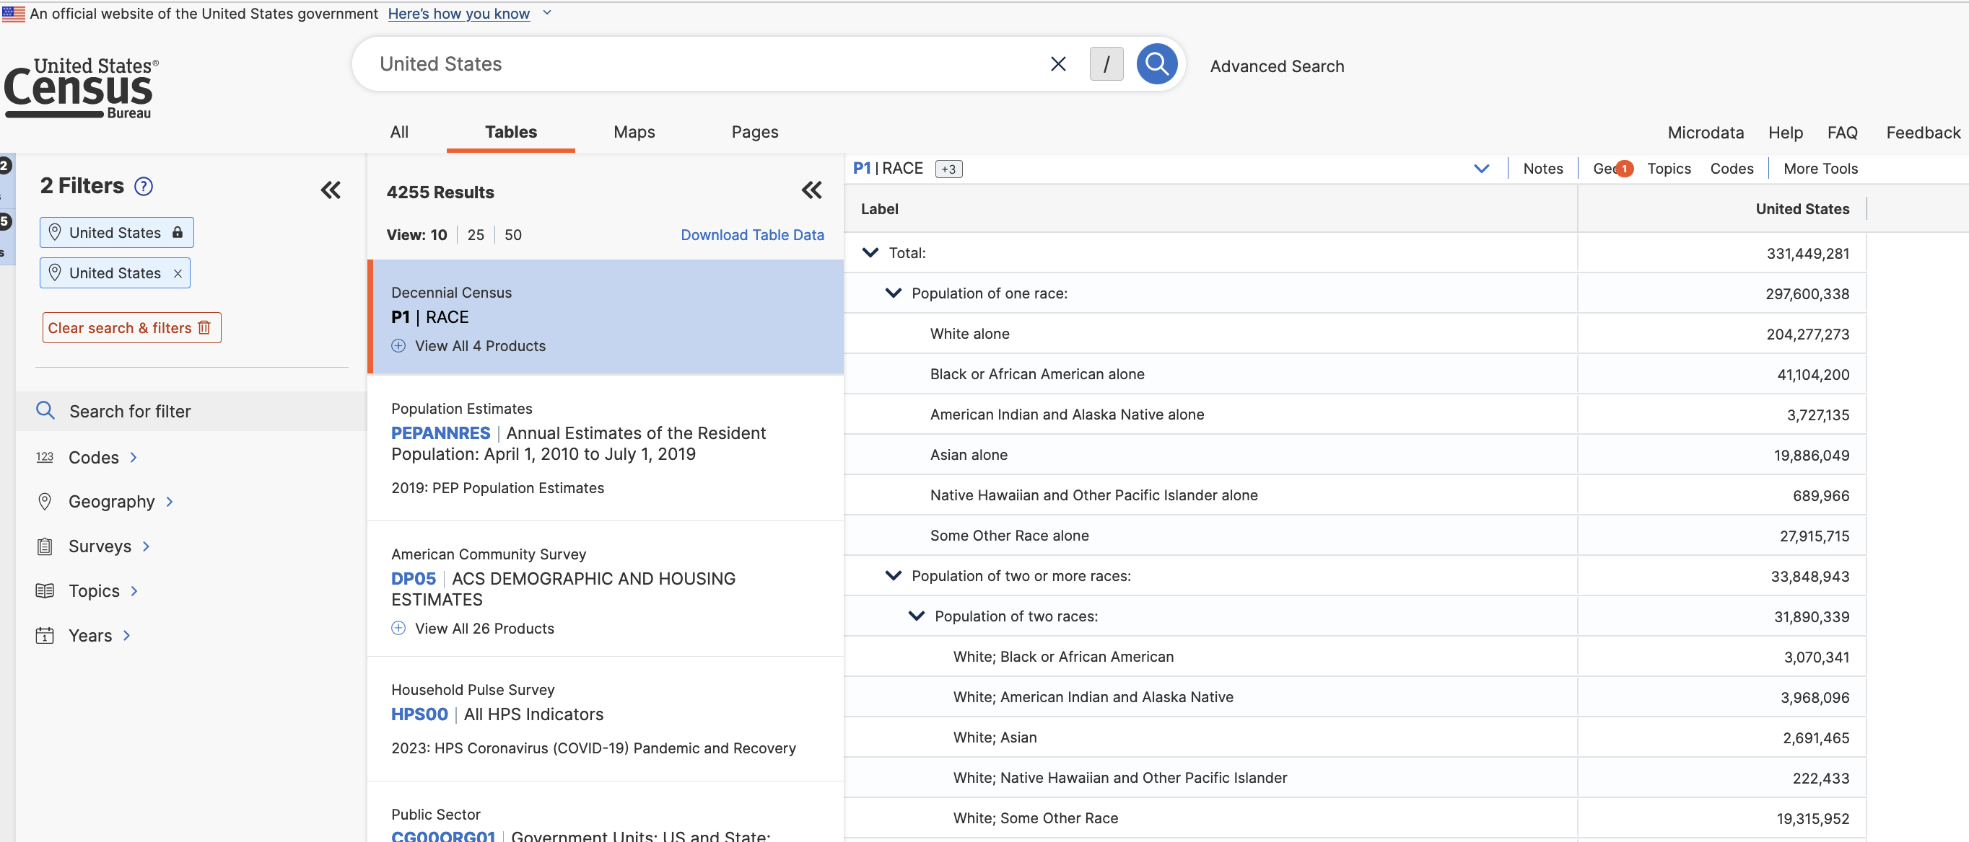
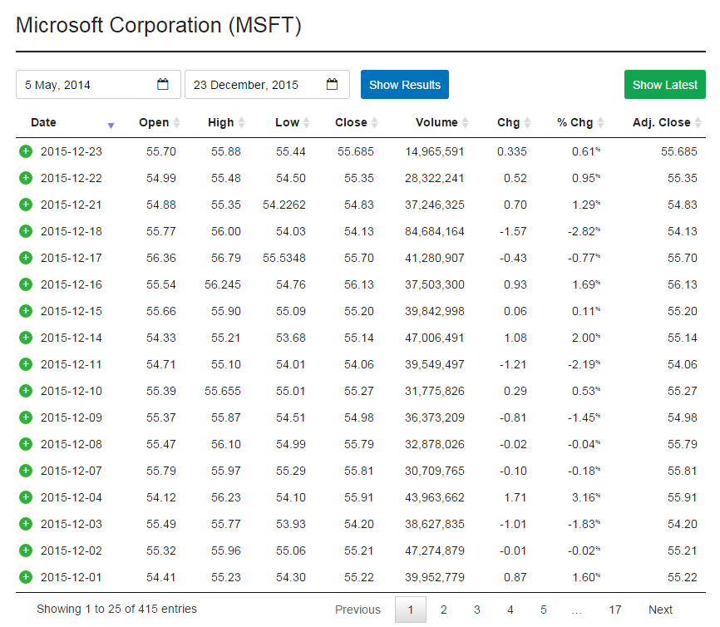
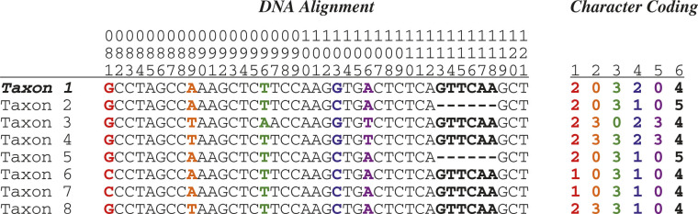
Data has many different formats
Government
DNA Sequence Data
Finance

Slide 9
What is data science
Data
Algorithm
=
+
Data
Science

Slide 10
How to analyze data
Statistics and probability
Data manipulation and cleaning
Data visualization and exploration
Machine learning algorithms
Big data and distributed computing
Ethics and bias in data science
… …
Algorithm

Slide 11
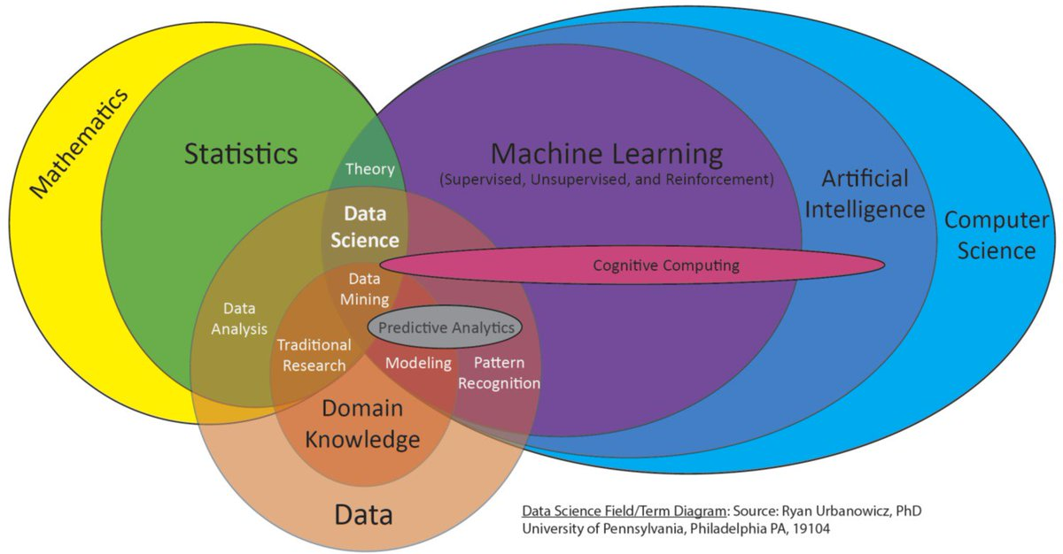
Data science is fundamentally interdisciplinary
一千个人眼中有一千个数据科学

Slide 12
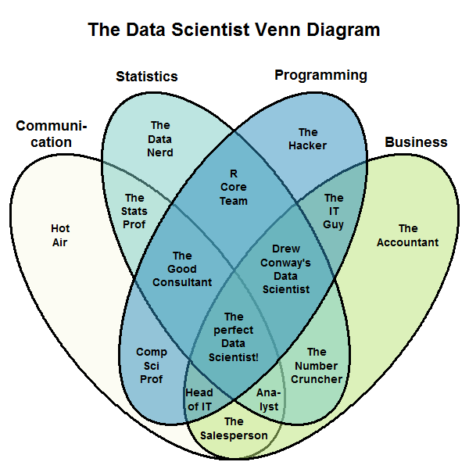
Data scientists are not just programmers
一千个人眼中有一千个数据科学（家）

Slide 13
Computer Science vs. Machine Learning vs. Data Science
=
Data
+
Algorithm
CS
ML
DS
CS
software
code-centric
maintenance
code-debugging
ML
ML/DL models
model-centric
model selection
model (re)training
DS
(critical thinking)
data+model+code
Hypothesis
Experiments
Observations

Slide 14
Data science is not just data and algorithm
Data
Algorithm
=
+
Data
Science
Ask the
right question
Find
good data
Use an
appropriate solution

Slide 15
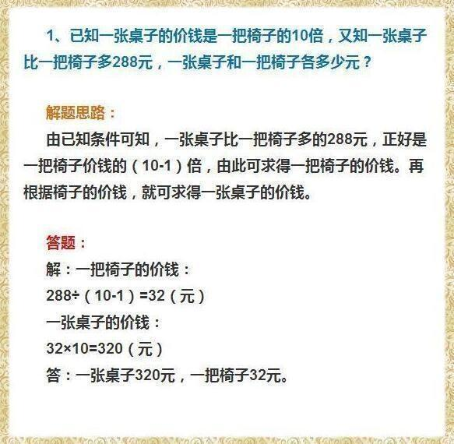
Ideal World
Well provided conditions
Your job: Find a solution
(equations)

Slide 16
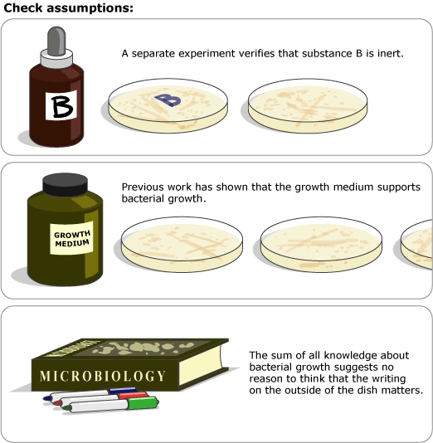
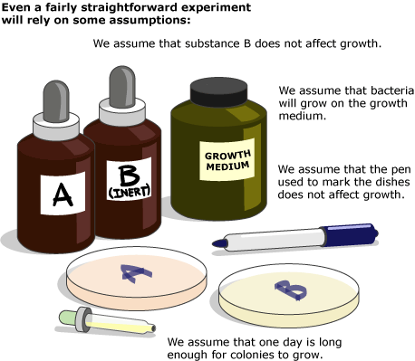
Assumptions need to well checked
Substance (物质) A stops bacterial growth
惰性的
Notes:
All scientific tests involve making assumptions — many of them justified, or will be violated in a different scenarios (say ML)

Slide 17
Quiz: Sample data science problems
What should we recommend to our user to watch?
What areas of the world are at higher risks for climate change impact in 10 years? 20?
Where should we put docking ports for our bikes?
What should we eat to avoid dying early of heart disease?
Do immigrants from poor countries have a positive or negative impact on the economy?
…
Notes:
These are sample data science questions from UCB Data Science course

Slide 18


Slide 19
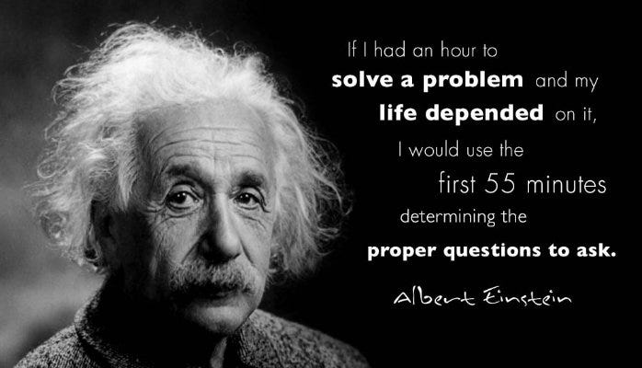

Slide 20
Ask the right question

Slide 21

什么是数据科学与分析？
Case 1: Cholera (霍乱)

Slide 22
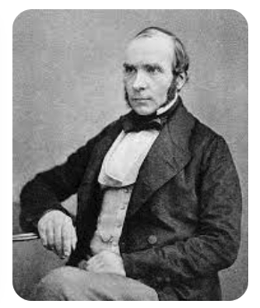
Data science + Epidemiology (流行病学)
Miasma theory: Cholera or the Black Death is caused by harmful forms such as population or "bad air”.
John Snow (physician, 内科医生)
He was not certain about the mechanism of disease transmission
Some evidence led him to believe that cholera was not caused by airborne transmission
Through communication with local residents, Snow determined that the public water pump was the source of contamination

Slide 23
Hypothesis (water) -> Data -> Observation
自来水公司 | 水源地 | 供应房屋数 | 霍乱死亡人数 | 死亡率
Lambeth | 泰晤士河上游 | 26,107 | 98 | 0.38%
Southwark & Vauxhall | 泰晤士河下游 | 40,046 | 1,263 | 3.15%

Slide 24
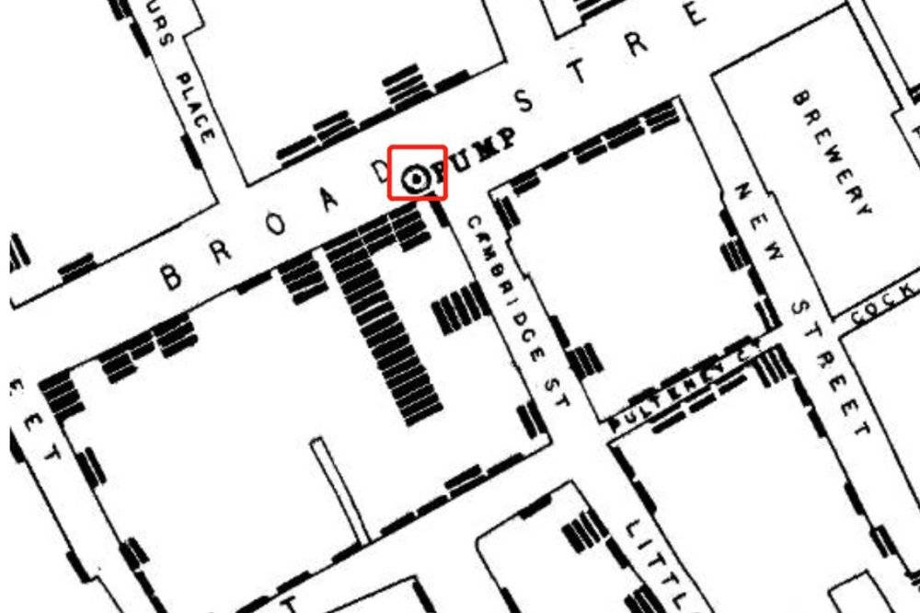
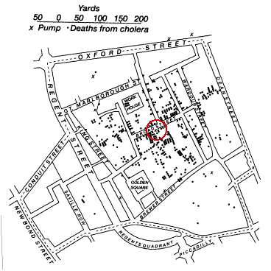
More data -> Visualization -> Insight
1854年英国伦敦霍乱患者分布与水井分布的地图

Slide 25
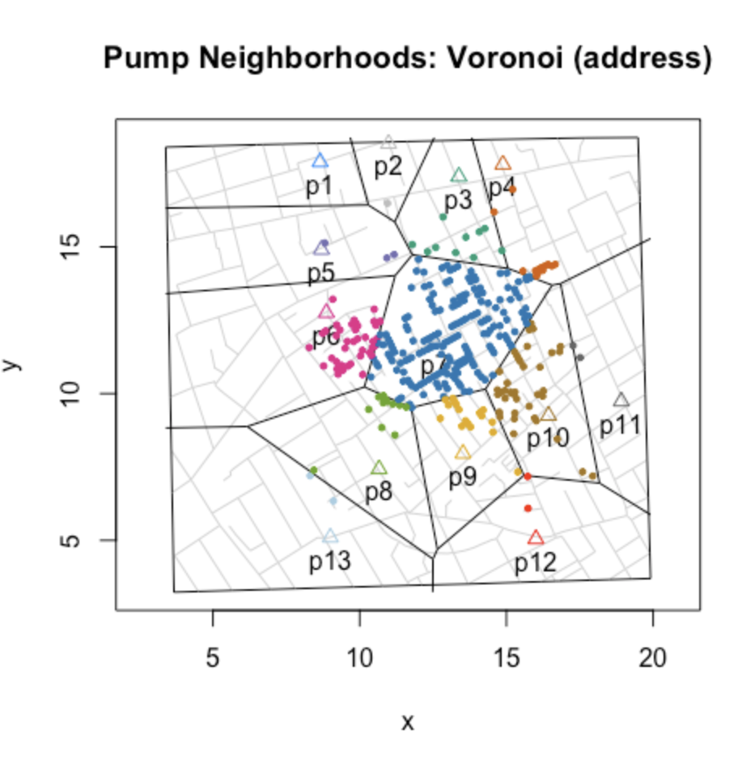
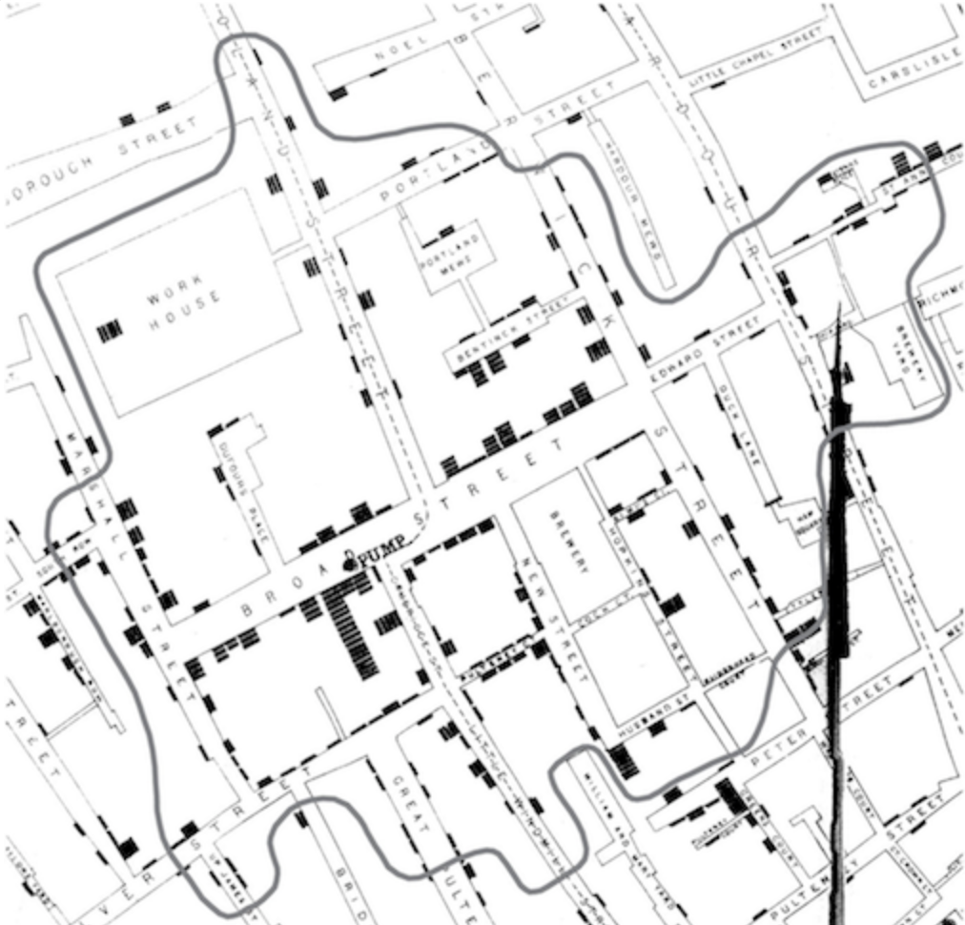
More data -> Visualization -> Insight
Pump’s (水泵) neighborhood

Slide 26
Ask the right question

Slide 27

Case 2: Self-driving car

Slide 28
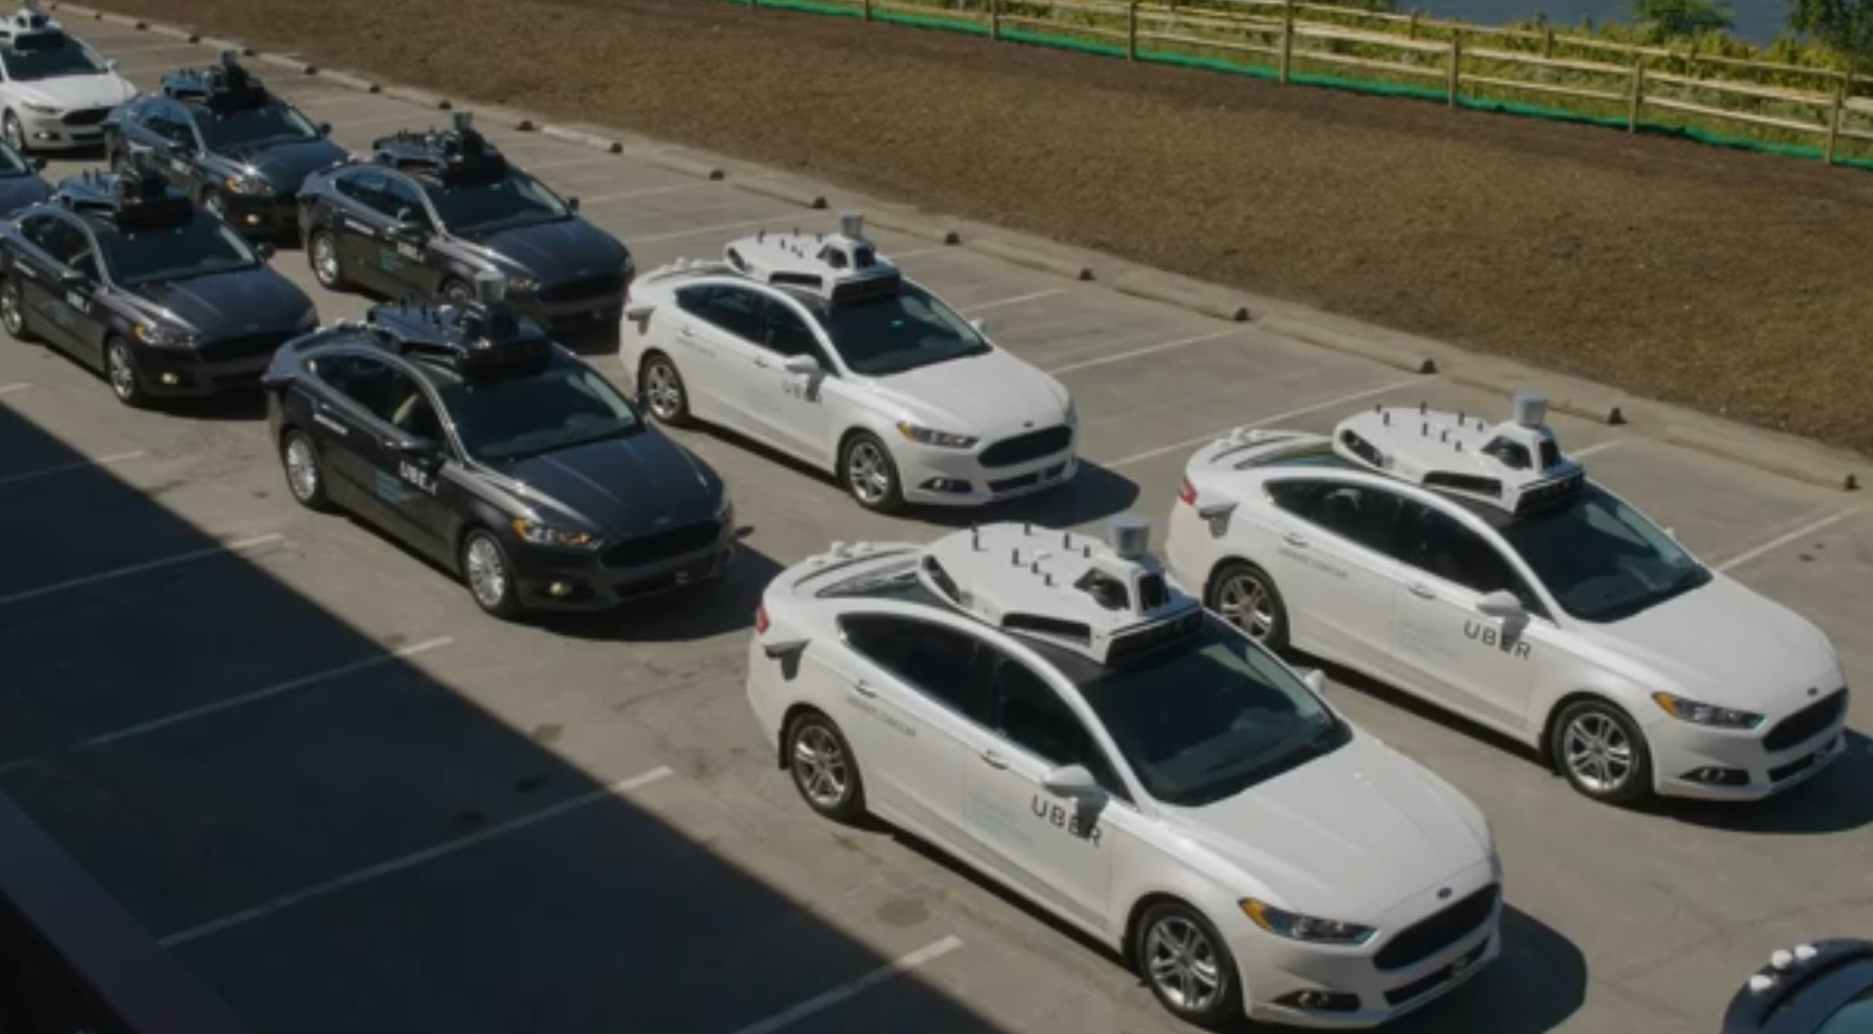
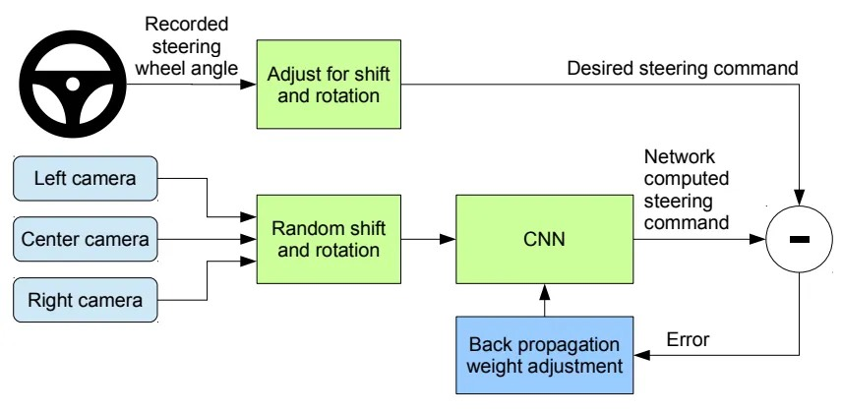
Data
Algorithm
+

Slide 29
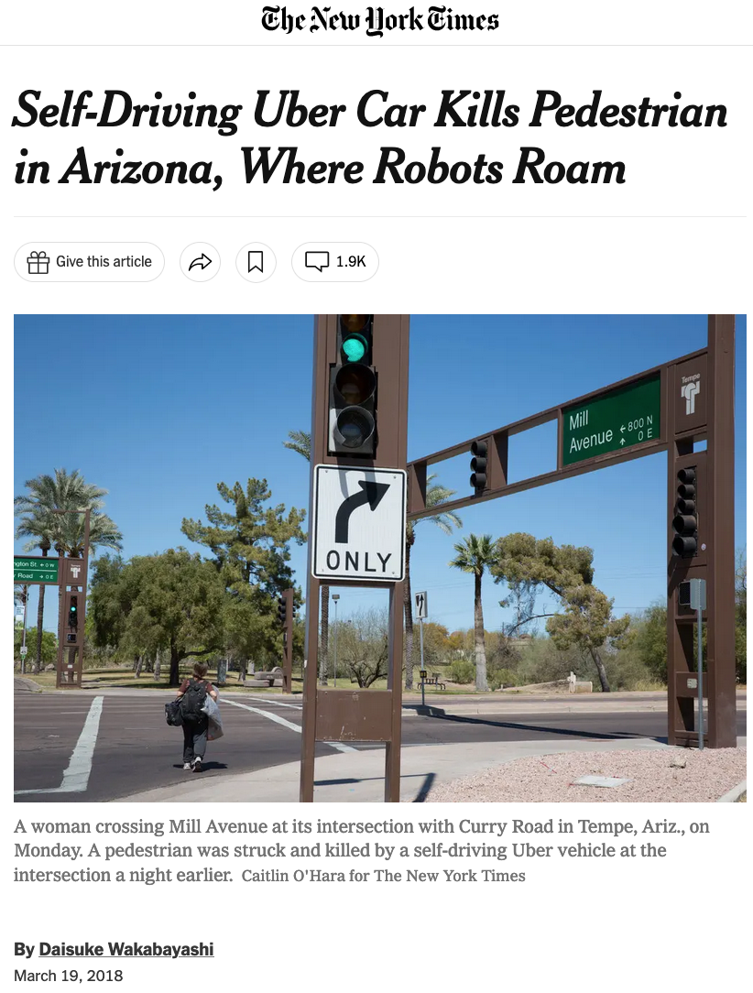
Failed to detect the pedestrian, because it was trained using a dataset that did not include many examples of jaywalking pedestrians.

Slide 30
Ask the right question

Slide 31

Case 3: Face Recognition

Slide 32
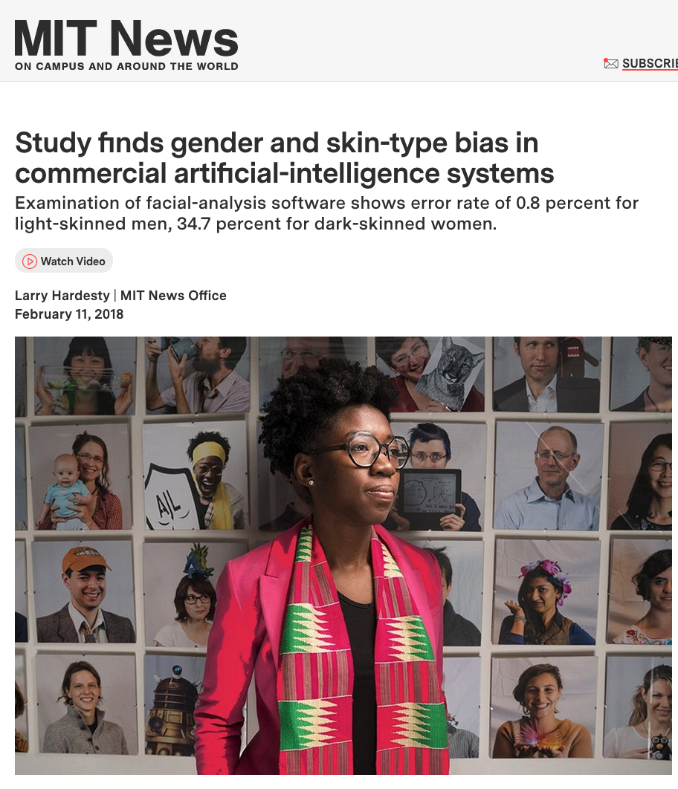

Slide 33

Source of video: [link]

Slide 34

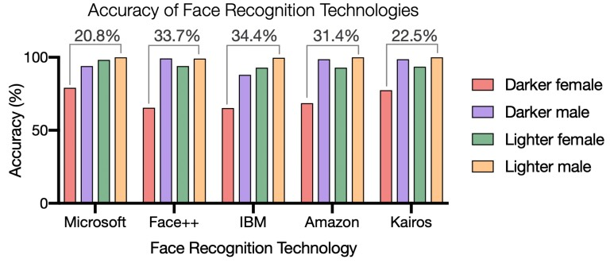

Slide 35
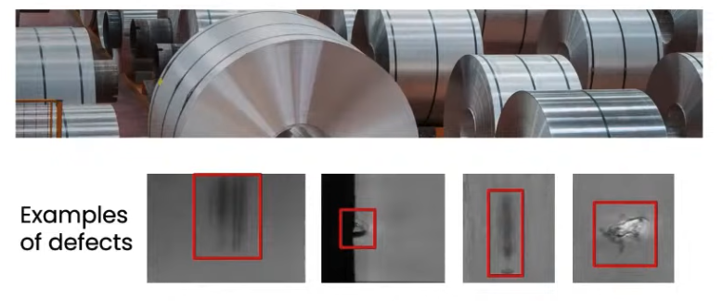
Case 4: Inspecting Steel Sheets for Defects [link]
Baseline systems: 76.2% accuracy
Target: 90.0% accuracy
Notes:
These steel sheets are used to make a car
There are 39 types of defects that the factory operators wanted to detect using computer vision
Target: 90.0% because that is how well human inspectors can spot these types of defects
This is important because you don’t want to buy a car and then find out some defects in the door of the car

Slide 36
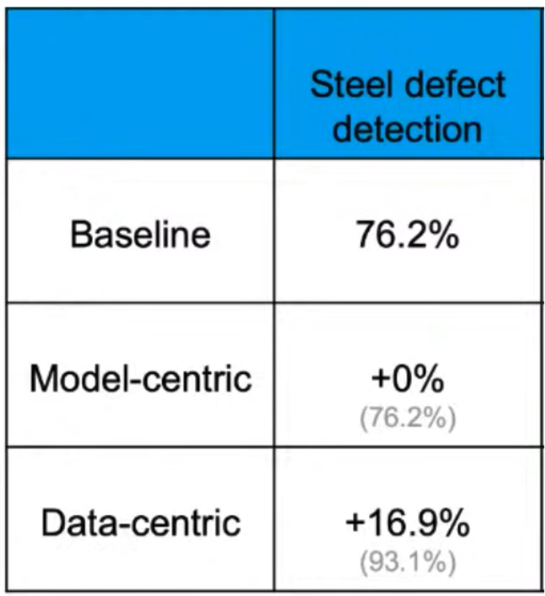

Case 4: Inspecting Steel Sheets for Defects [link]

Slide 37
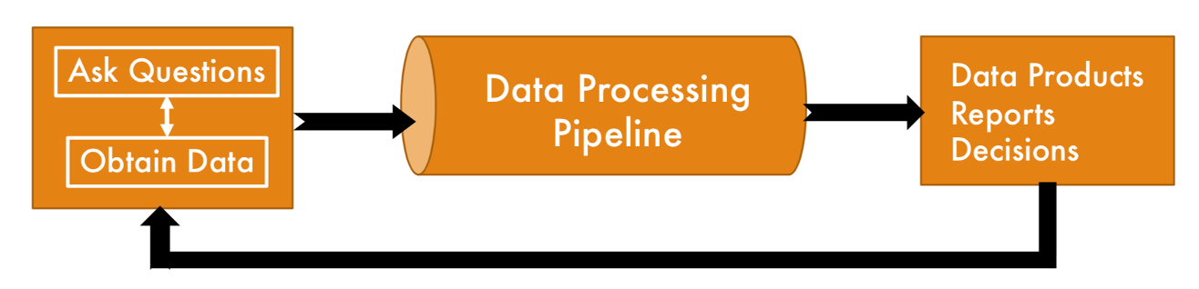
Life-cycle of data science

Slide 38
What is data science
Good data
Good algorithm
Interdisciplinary
More importantly … …
Critical thinking: ask the right question
Life-cycle of data science

Slide 39
Lecture 1: An overview of data science
What is data science
Why is data science important
Core skills in data science

Slide 40
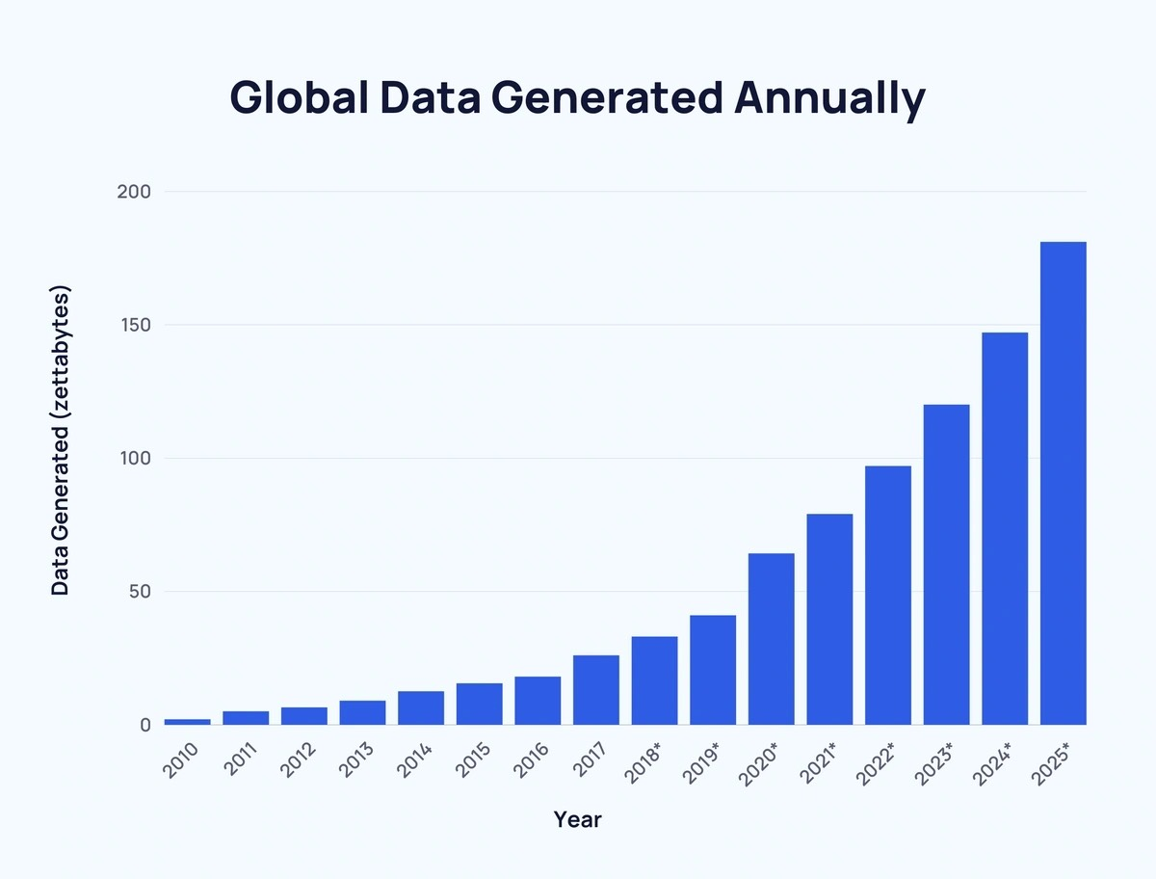
Data is changing the world - the era of big data

Slide 41
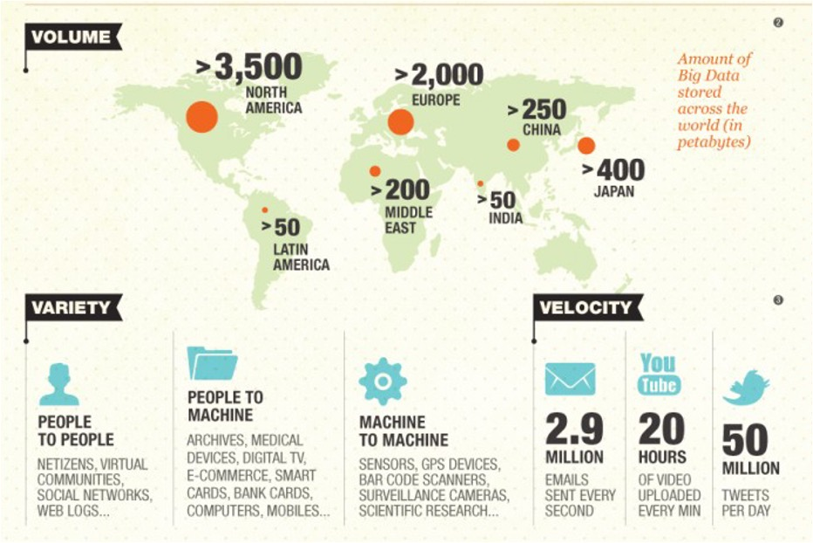
3 V’s of big data
Volume
GB -> TB -> ZB -> EB
Velocity
Fast data flows
Variety
Diversity

Slide 42
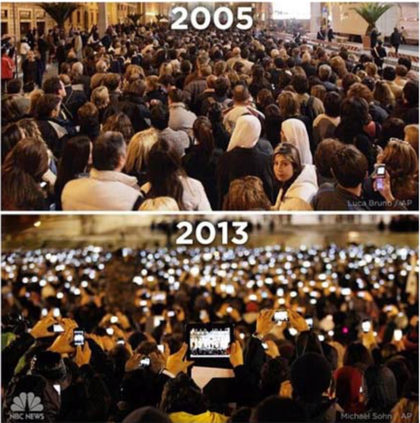


People's behavior has undergone profound changes
数字痕迹
Digital Traces

Slide 43
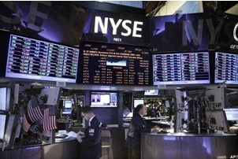


Digital Traces
The New York Stock Exchange generates 1TB of trading data every trading day.
Facebook receives approximately 500+ terabytes of social data from users every day, mainly consisting of photos, videos, text messages, comments, etc
The 2019 Spring Festival Gala (春晚) had a global audience participation of 20.8 billion interactions through Baidu APP
Trend 1: Data is easier to generate and obtain than ever before

Slide 44
Data has changed and is changing the entire world
The development trend of the information technology industry
1980s: Hardware industry -> selling machines
1990s: Software industry -> selling computer software
2000s: Internet industry -> online retail and service
2010s: Data industry -> Data Empowerment
Enhancing user experience (e.g., personalized recommendations)
Solving real-world hard problems (e.g., Alibaba's City Brain 城市大脑)
Reducing travel time in Hangzhou by 15.3%, saving 4.6 minutes of travel time on major elevated highways, and dropping from the fifth most congested city in China to the 57th
Saving enterprise costs (e.g., UPS in the United States)
Designing routes through data analysis ("UPS drivers don't turn left"), saving 100 million miles of transportation per year

Slide 45
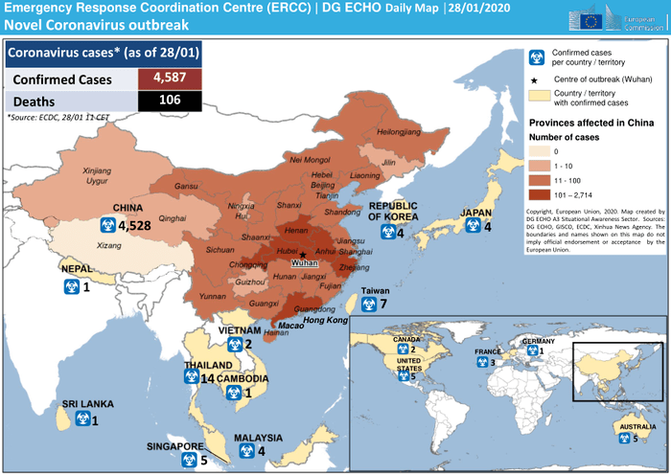
Government: data-driven response to COVID19

Slide 46
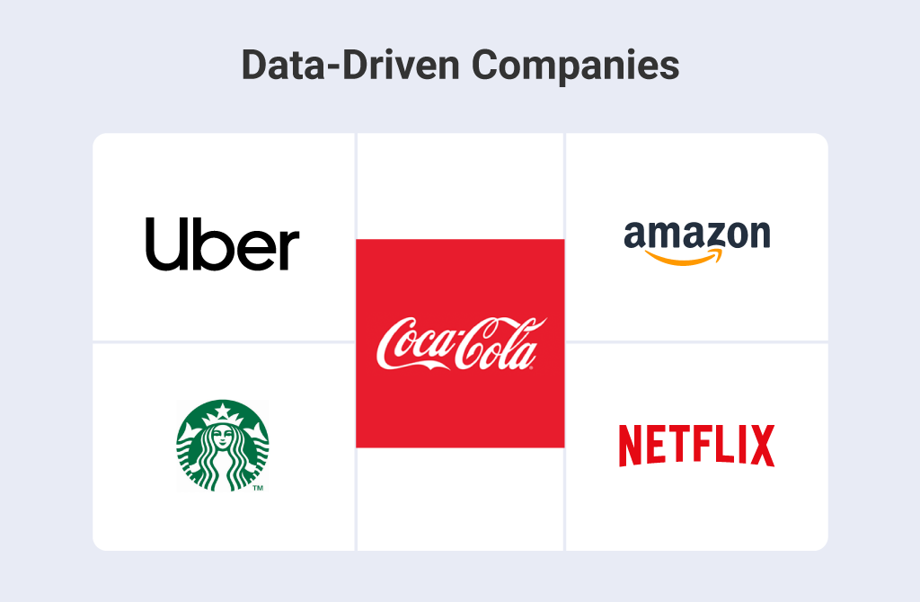
Companies: data-driven decision making
Coca-Cola
sourcing, distribution, sales, …
Starbucks
big data through mobile apps and reward programs that help them gather insights directly from its customers

Slide 47
Daily decisions: data-driven life
Everything is based on data that help us to make everyday decision
We will continue to make personal decisions based on experience, reasoning, and emotions
But, data (camouflaged under friendly interfaces) is already part of the way in which technology has impelled us:
Music, movies, books, food, online shopping
Trend 2: People’s decisions are more data-driven than ever before

Slide 48
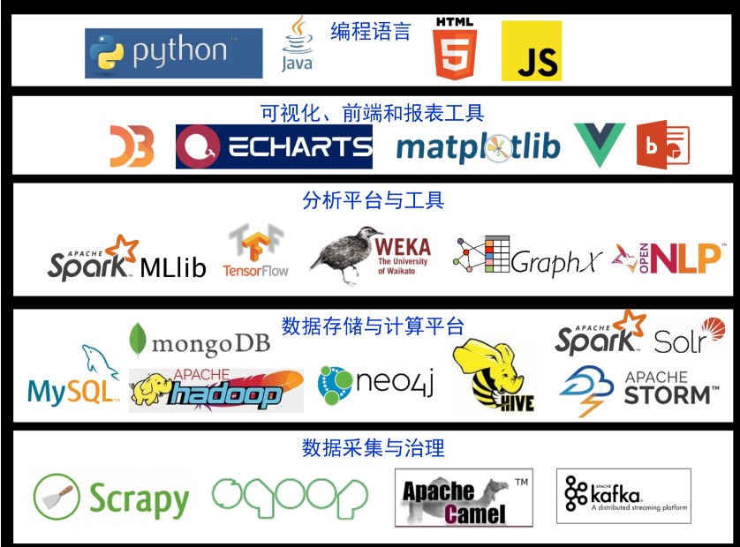
The ability to analyze data is increasing

Slide 49

Why is data science important
Data is easier to generate and obtain than ever before
People’s decisions are more data-driven than ever before
Tools for data analysis are being democratized

Slide 50
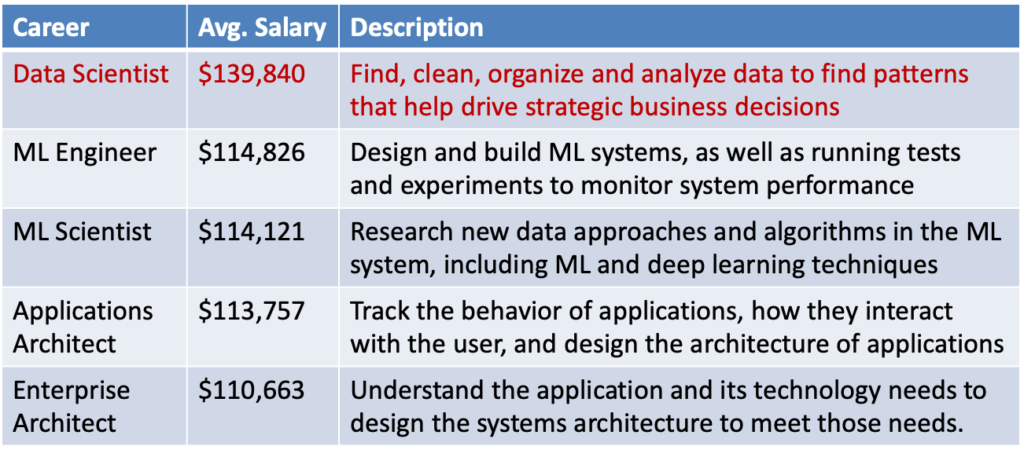
参考：https://www.northeastern.edu/graduate/blog/data-science-careers-shaping-our-future/

Slide 51
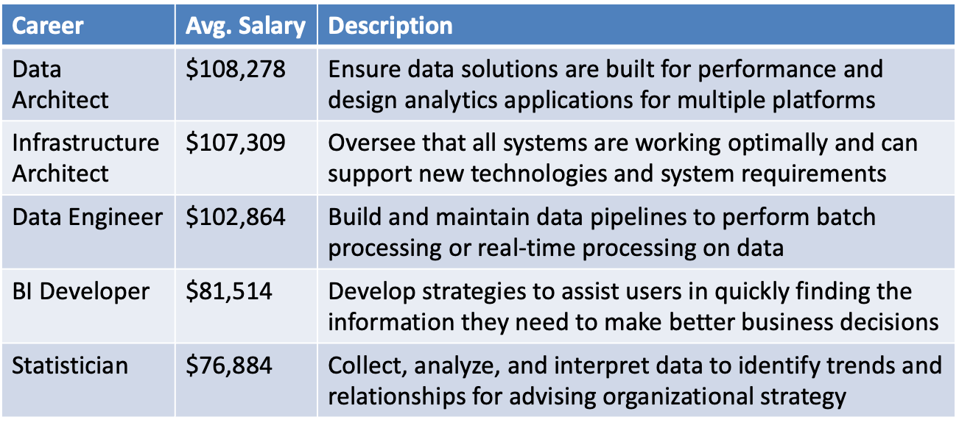

Slide 52
Lecture 1: An overview of data science
What is data science
Why is data science important
Core skills in data science

Slide 53
Core skills
Data preparation (effectiveness, high-quality)

Slide 54
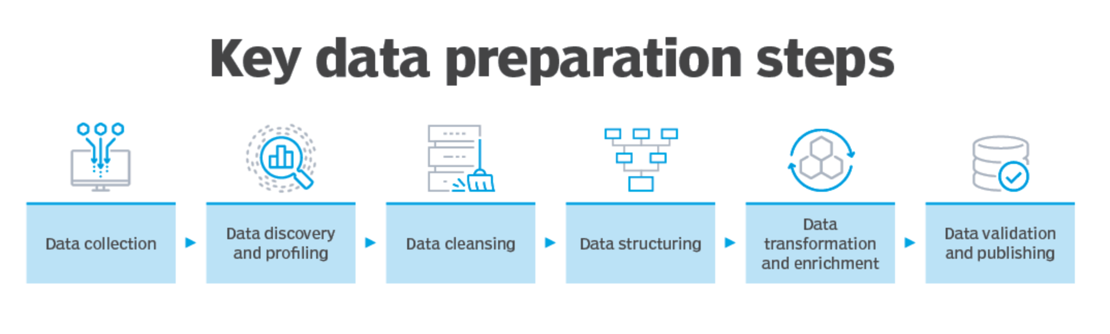

Slide 55
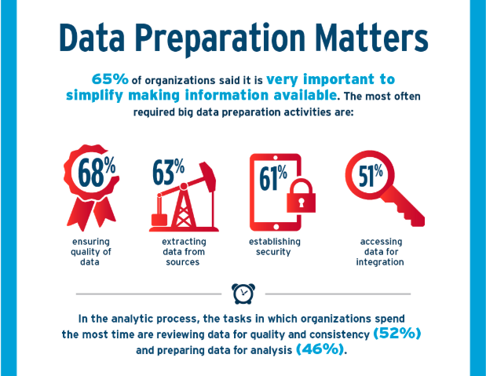

Slide 56
Core skills
Data preparation (effectiveness, high-quality)
Big data processing (efficiency, scalability)

Slide 57
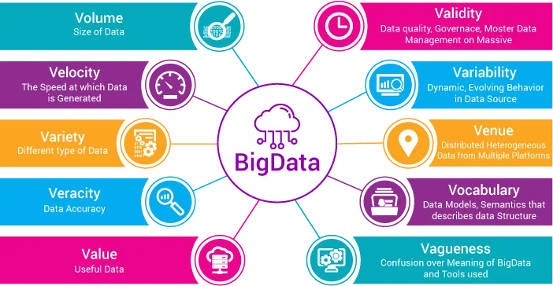

Slide 58
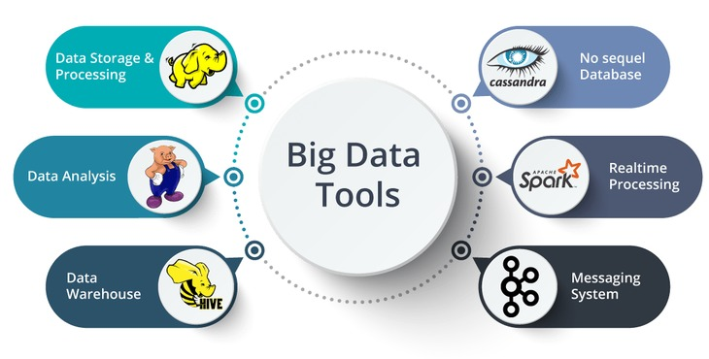

Slide 59
Core skills
Data preparation (effectiveness, high-quality)
Big data processing (efficiency, scalability)
Statistics (patterns, anomaly)

Slide 60
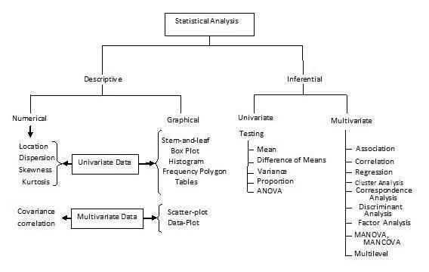
Understanding Statistics

Slide 61
Core skills
Data preparation (effectiveness, high-quality)
Big data processing (efficiency, scalability)
Statistics (patterns, anomaly)
Machine learning and deep learning (powerful black-boxes)

Slide 62


Slide 63

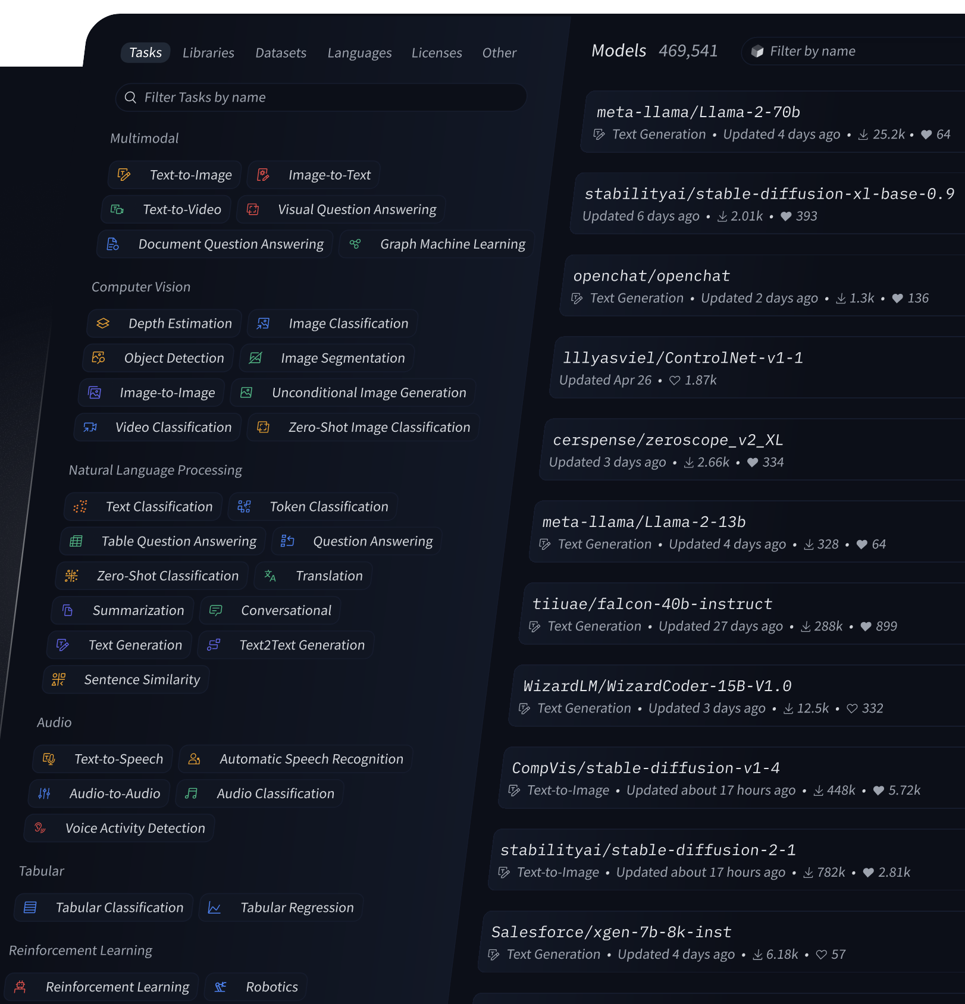
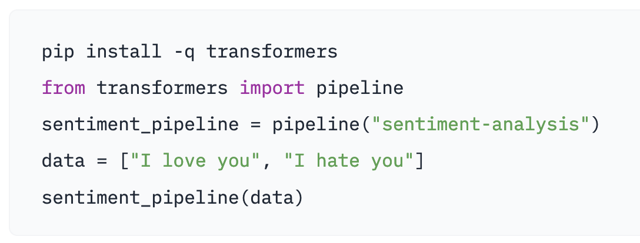
Machine Learning
Scikit-learn
Pytorch, Tensorflow
Hugging Face

Slide 64
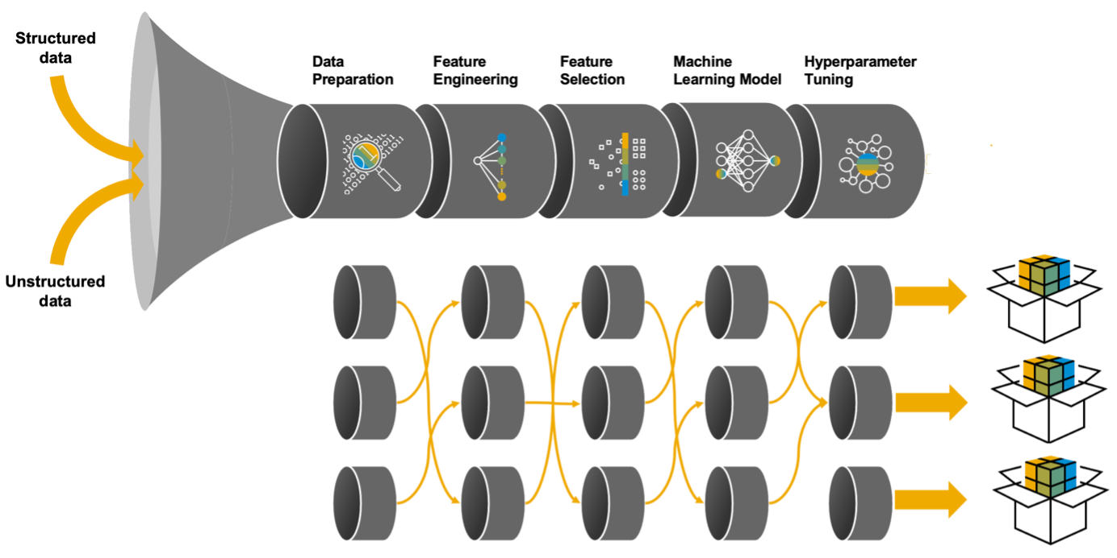
AutoML
Trend 3: Tools for data analysis are being democratized

Slide 65
Core skills
Data preparation (effectiveness, high-quality)
Big data processing (efficiency, scalability)
Statistics (patterns, anomaly)
Machine learning and deep learning (powerful black-boxes)
Data exploration and visualization (understanding)

Slide 66
Graphs and Charts
Interactive Dashboards
Geospatial Mapping
Visual representations such as bar graphs, pie charts, and line graphs for conveying data trends and patterns.
Dynamic visualizations that allow users to explore and analyze data through interactive controls and elements.
Utilizing maps to visualize and analyze data associated with specific geographic locations and spatial distributions.

Slide 67
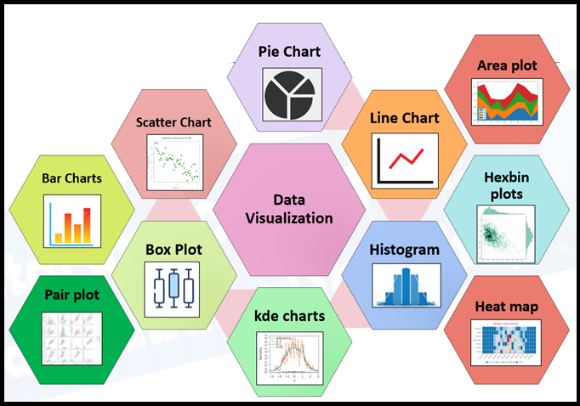

Slide 68
Core skills
Data preparation (effectiveness, high-quality)
Big data processing (efficiency, scalability)
Statistics (patterns, anomaly)
Machine learning and deep learning (powerful black-boxes)
Data exploration and visualization (understanding)
Ethical consideration

Slide 69
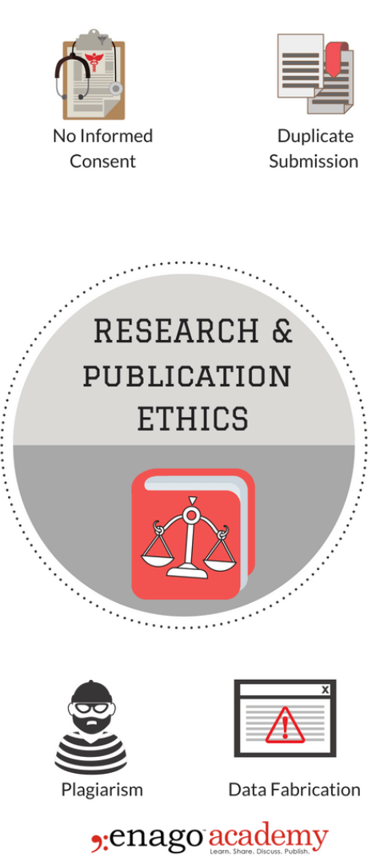
Data Privacy
Ensuring data protection and respecting the privacy of individuals and organizations in data handling and analysis.
Transparency
Transparent communication and documentation of data sources and methodologies used in analysis and decision-making.
Fairness
Addressing biases and ensuring fair and equitable treatment of all groups represented in the data.

Slide 70
Core skills
Data preparation (effectiveness, high-quality)
Big data processing (efficiency, scalability)
Statistics (patterns, anomaly)
Machine learning and deep learning (powerful black-boxes)
Data exploration and visualization (understanding)
Ethical consideration
Highly practical: putting all pieces together for real-world problems

